Slide 1

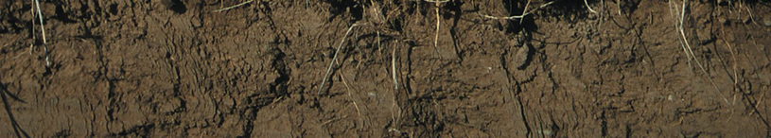
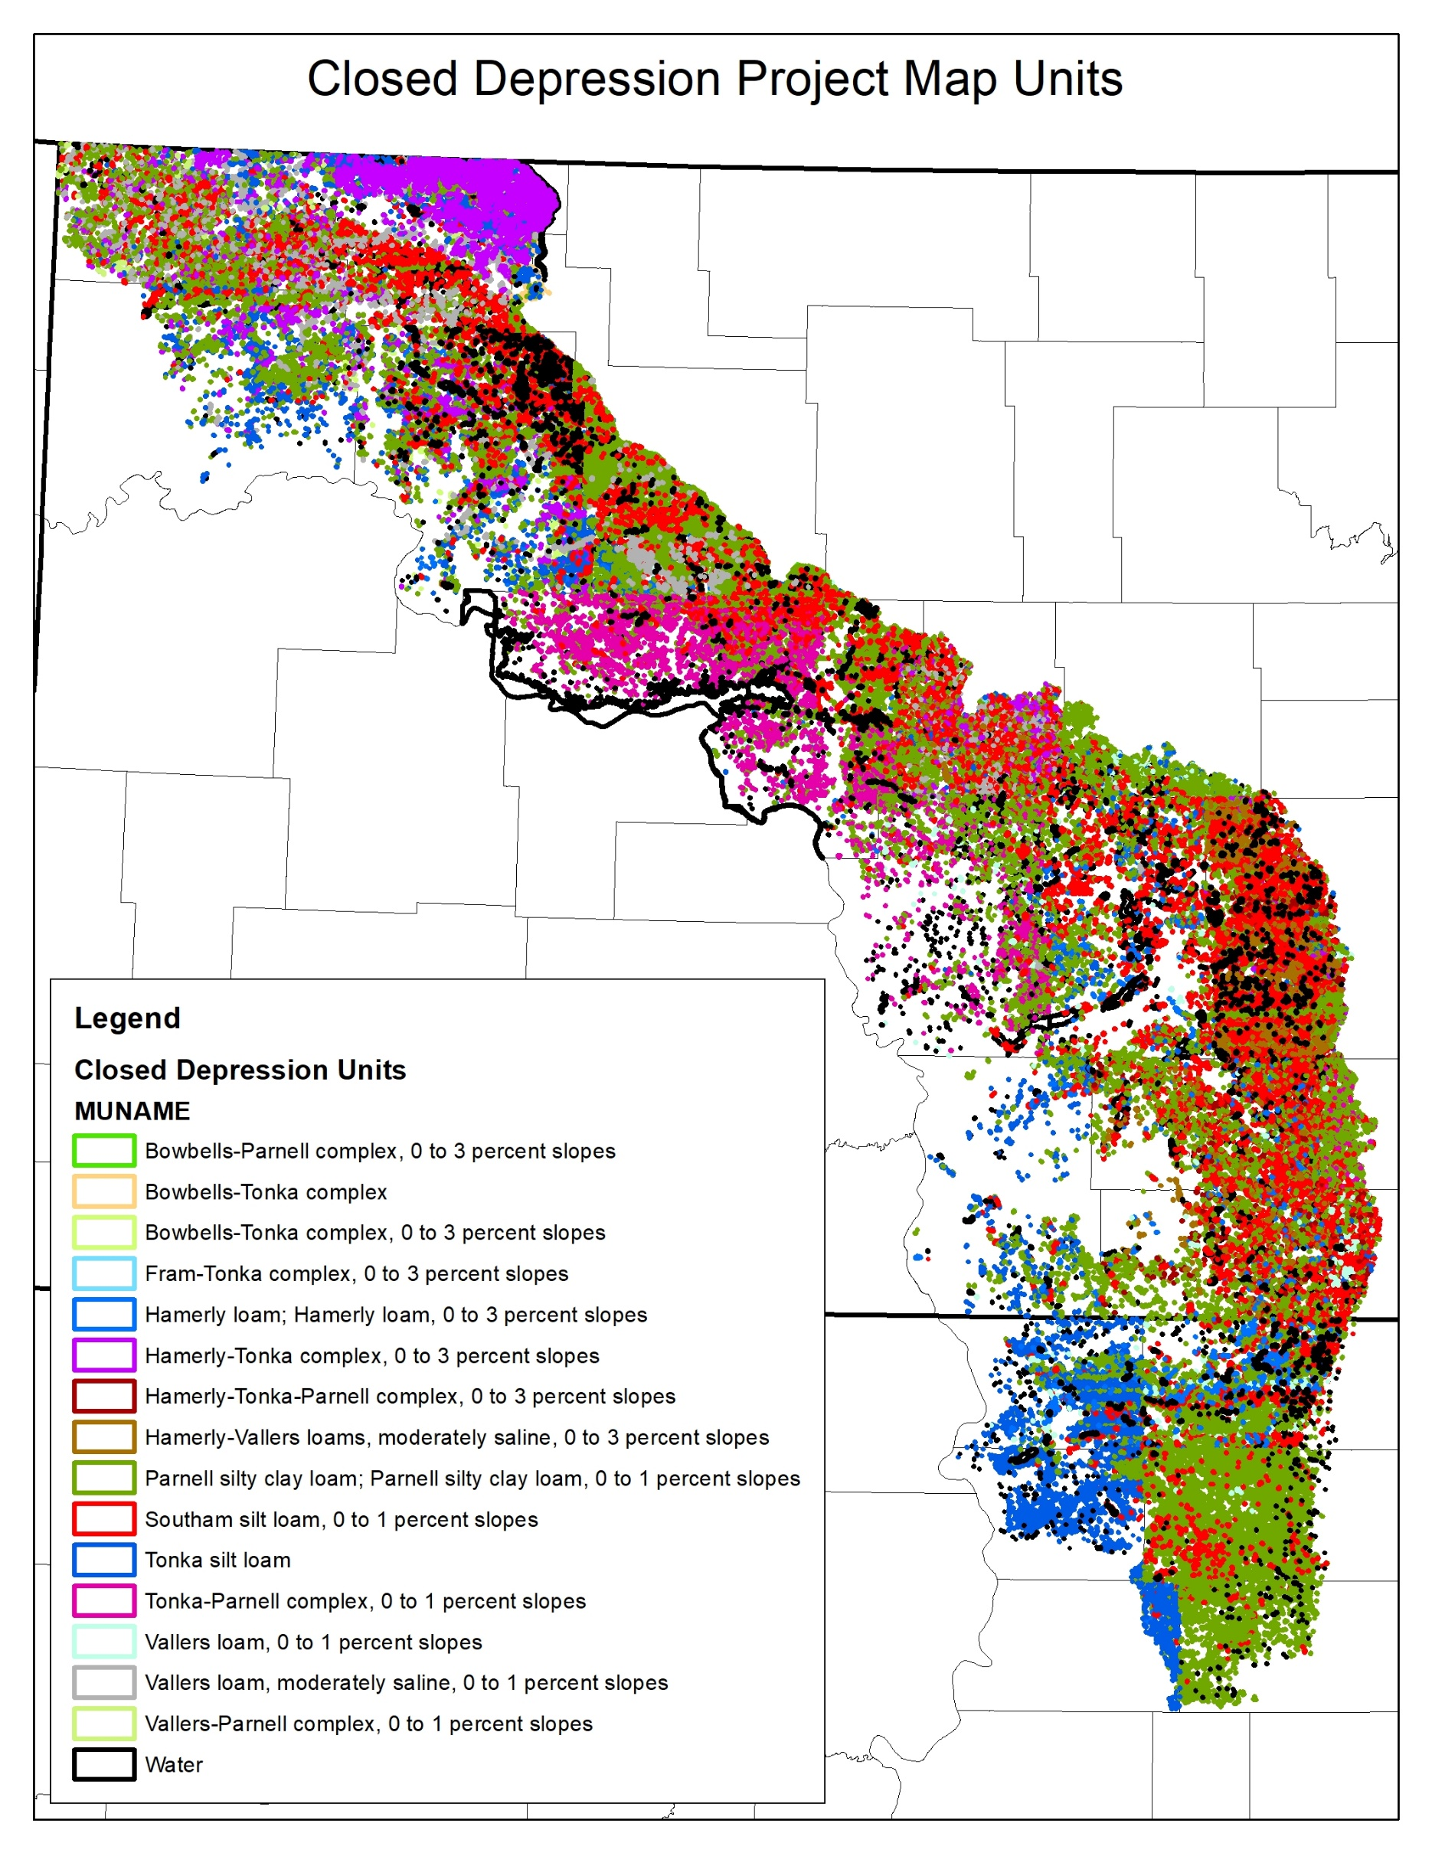

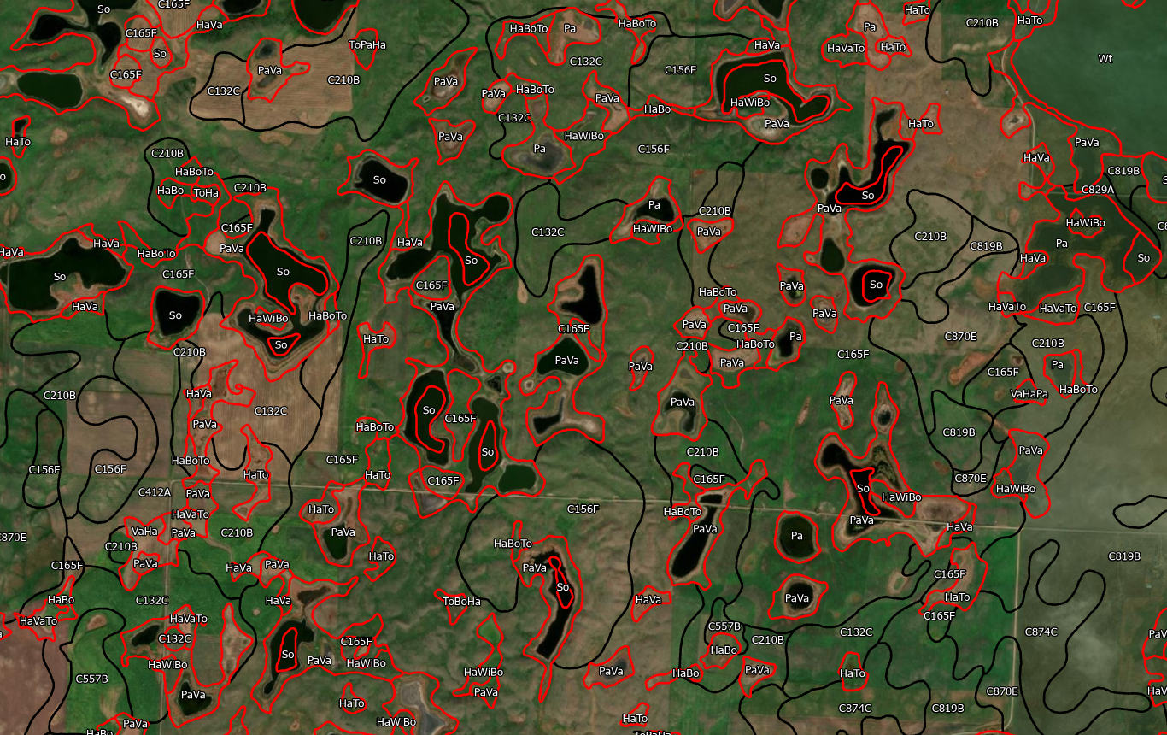
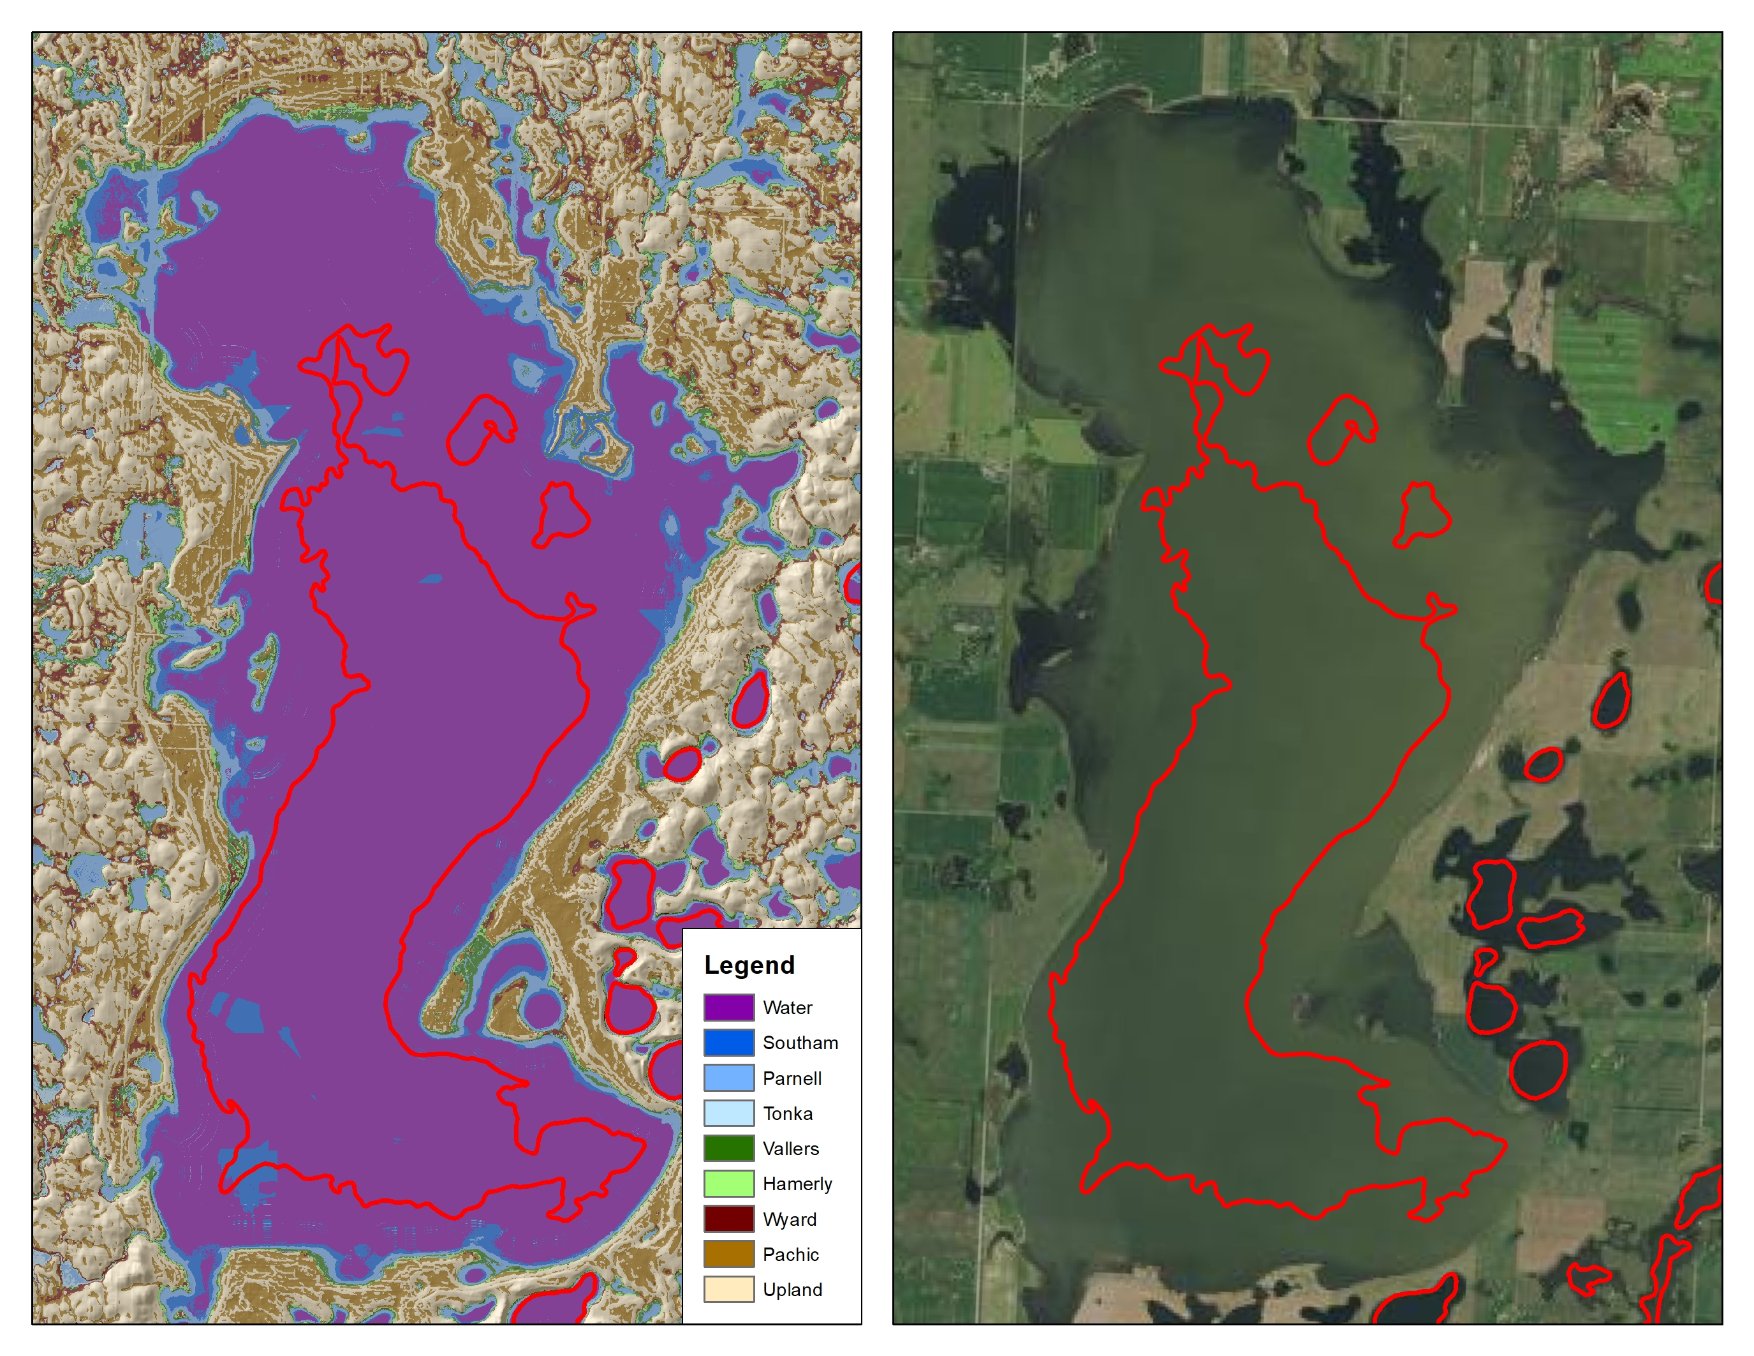

MLRA 53B – Closed Depression Project and Digital Soil Model Creation
Soil And Plant Science Division
West Central Glaciated Soil Survey Region 10
Purpose
The purpose of this project is to create a Raster Soil Survey Product with the set goal of improving the consistency and accuracy with which closed depressions are mapped. A secondary outcome would include updating spatial boundaries and tabular data by improving consistency across county and state boundaries. Finally, to refine soil properties from all available data; specifically, soil moisture state and calcium carbonate expression.
Process
Terrain and Spectral data were used to generate training data points that were sampled to aid in soil model development. Numerous models were developed representing important soil characteristics such as depth to aquic conditions, ponding duration, and others. These models were used to develop criteria for each of the modeled soil classes. Each soil class was checked for accuracy and led to the final correlation of the Raster Soil Survey. New SSURGO delineations and map units were correlated using the Raster Soil Survey.
Challenges
The primary challenge with the project was the overall size. Covering the entire MLRA created issues with processing and editing.
Conclusion
Raster soil survey product providing a more detailed representation of soil spatial variability across the project area.
Update spatial boundaries and tabular data
Improve consistency across county and state boundaries
More accurately represents boundaries of water which have changed over the decades since they were originally mapped
Primary Soil Characteristics
Aquic Conditions
Mollic Epipedon
Identifiable Secondary Carbonates
Imagery and Software
LiDAR coverage for all of ND
MNDWI from LANDSAT composite
ArcMap, ArcSIE, SAGA, RStudio
Figure 1: Correlation issues of depressional map units between county subset
Figure 3: New SSURGO delineations (red lines) created using the Raster Soil Survey.
Background
In 2019 the 10-BIS MLRA Soil Survey Office began a two-year project utilizing digital soil mapping technology to consistently map closed depressions and produce a Raster soil survey product of the numerous closed depressions found in the Missouri Coteau. The Missouri Coteau in MLRA 53B is a major landform extending from the US-Canadian border in Divide County, North Dakota to Faulk County, South Dakota. Landforms consist of closely spaced hills and knolls alternating with marshy depressions or potholes Stream drainage is uncommon or absent and numerous pothole wetlands occur between the mounds of glacial till.
Future Work
This project is the first Raster Soil Survey product produced for the Missouri Coteau. Knowledge and skills gained in this project can be used to complete investigations of future MLRA 53B soil mapping updates.
There is some obtrusion with natric soils that presents challenges for modeling. A follow-up project may be necessary in the future in these areas.
Figure 2: Original Water delineation in red on the Raster Soil Survey (left) and ortho imagery (right).
Natural Resources Conservation Service l Soil and Plant Science Division l nrcs.usda.gov/soils

